Slide 1


THE COST OF POVERTY
DECEMBER 12, 2014

Slide 2
Poverty Simulation
FACILITATORS
Charlotte Tharp, Tyler Independent School District
Vernora Jones, Tyler Independent School District
Roxane May, Department for the Elimination of Disparities and Disproportionality
Paul Andrews, Ph.D., Independent Psychologist
VOLUNTEERS
Leadership Tyler Alumni

Slide 3
Community Action Poverty Simulation
Can You Survive A Month in Poverty?

Slide 4
Could You Survive a Month in Poverty?
Millions of Americans live in poverty every day
Includes millions of children under the age of 18
Many more have incomes above the poverty line but are still low enough to qualify for programs like Food Stamps and Medicaid.
Walk A Mile In the shoes of those
facing poverty every day!

Slide 5
The Simulation Experience
Introduction and briefing
Actual Simulation exercise
Debriefing period of participants and volunteers

Slide 6
The Simulation Experience
It is a simulation, not a game.
Some families are:
  Newly unemployed
  Recently deserted by a “breadwinner”
  Homeless
  Senior Citizens on disability or retirement
  Grandparents raising grandchildren

Slide 7
The Task
Successfully provide for basic necessities and shelter during the course of four 15 minute “weeks” for your family.

Slide 8
The Process
Each participant will experience the virtual realities of poverty for one month divided into four 15-minute weeks.
Each family group has a packet to guide their actions during the simulation. The packet is placed under a designated chair.
  Do not open packet until instructed to do so by the facilitator
  Do not move chairs
Tables in the perimeter represent community resources and services for families such as:
  Bank, super center, community action agency, employer, utility company pawn broker, grocery, social service agency, faith-based agency, payday and title load facility, mortgage company, school, community health center, and child care center.

Slide 9
The Procedure
Proceed to the simulation area when instructed to do so
Choose a chair in the center of the simulation area.
Fill all seats in each family unit completely
Wait for further directions from the simulation facilitator.

Slide 10
The Anticipated Outcome
Understand the complexities and frustrations of living in poverty day to day
Become awareness of its impact on our community
Effectively address the poverty issues in our community

Slide 11
THE COST OF POVERTY
DECEMBER 12, 2014
Notes:
Luncheon. Leave on the screen during opening prayer and Lisa Lujan’s introduction of Christina.

Slide 12
Christina Fulsom
East Texas Human Needs Network

Slide 13
POVERTY
THE LOSS OF HUMAN POTENTIAL
Notes:
How we learn about poverty

Slide 14
HOW WE LEARN ABOUT POVERTY
Notes:
AS A CHILD. PLACE OF WORSHIP, SCHOOL, HOME. IMAGES ON TV OF CHILDREN WITH SWOLLEN BELLIES.
MAYBE ITS NOT ABOUT ME – NOT IN US
THEN YOU SEE IT
WE ARE MADE FOR GOODNESS
YOU WANT TO HELP BUT DON’T KNOW HOW
SO MUCH AT STAKE
THE STARFISH STORY…..

Slide 15
BE CURIOUS NOT JUDGEMENTAL
Notes:
ASK QUESTIONS
LISTEN TO STORIES
SOMETIMES WE DON’T SEE IT UNTIL IT AFFECTS US

Slide 16
POVERTY
Poverty Threshold or the Poverty Line, is the minimum level of resources that our government states are adequate to meet basic needs.

Slide 17
Data Type | 2008 | 2009 | 2010 | 2011 | 2012
Number | 10,078 | 12,428 | 11,529 | 12,666 | 13,159
Percent | 19.8% | 23.9% | 21.7% | 23.6% | 24.5%

Slide 18

Data Type | 2008 | 2009 | 2010 | 2011 | 2012
Number | 25,756 | 32,316 | 30,864 | 35,744 | 36,260
Percent | 13.1% | 16.2% | 15.0% | 17.1% | 17.2%

Slide 19
SOCIAL SERVICES PURPOSE
ALLEVIATE
PREVENT
SUPPORT TRANSITION
ELIMINATE
Notes:
ALLEVIATE- snap, tanf, Medicaid, shelters, most nonprofits
PREVENT – early childhood development, education
SUPPORT TRANSITION – Workforce, healthcare, affordable housing, childcare, transportation
ELIMINATE – Collective Action – poverty is not acceptable

Slide 20
INSANITY
Doing the same thing over and over again and expecting different results!
- Albert Einstein
Notes:
THE NUMBERS ARE GOING IN THE SAME DIRECTION. IF WE KEEP DOING WHAT WE ARE DOING IT WILL KEEP GETTING WORSE.

Slide 21
Want to go fast, go alone.
Wang to go far, go together.

Slide 22

COMMON GOAL
Improve the wellbeing of others

Slide 23
VISION
A community with equitable
access for all

Slide 24
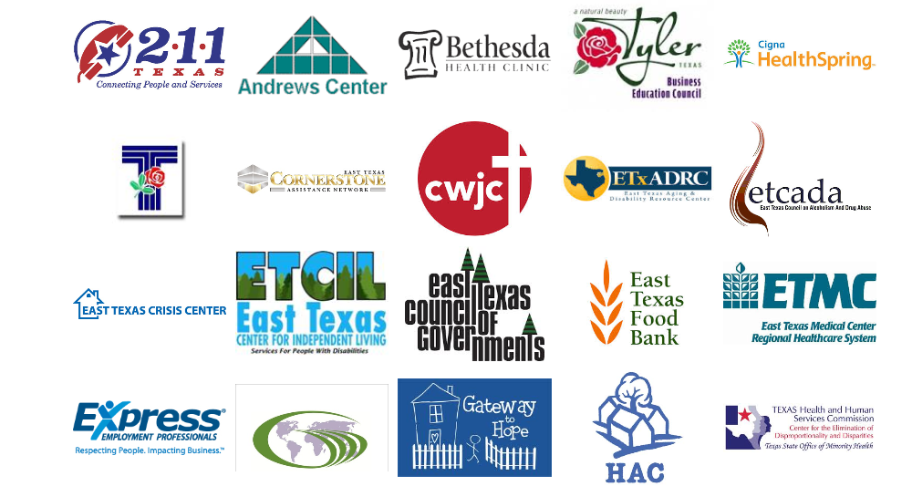
WHO?

Slide 25
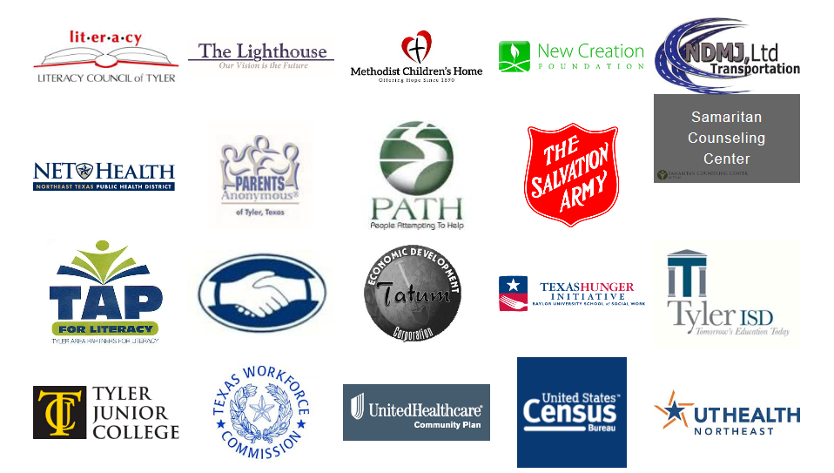
WHO?

Slide 26
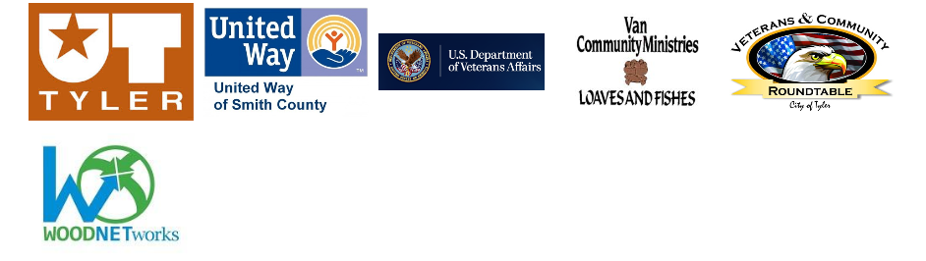
WHO?

Slide 27
DATA

Slide 28















38
Interviewers
14
Agencies
341 households
1052 individuals

Slide 29
URGENCY

Slide 30

BETTY 33%
Lost job
Living with her mom and 2 y.o. baby
Needs GED
Notes:
#1 NEED - TUITION

Slide 31
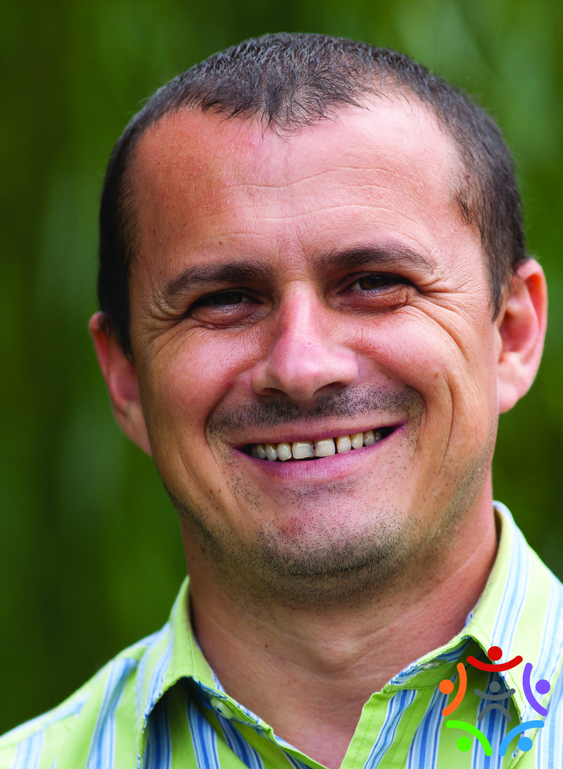
HARRY 42%
Laid off after 16 years
Can’t find work for same wages
Sold home, truck, stuff
Desperate to find work
Notes:
A JOB EMPOWERS AN INDIVIDUAL TO USE HIS POWERS AND ABILITIES TO PROVIDE FOR THEIR OWN FAMILY, RESTORING A SENSE OF PURPOSE, HOPE AND DIGNITY.
#1 NEED – JOB TRAINING

Slide 32

LINDA 44%
Working
No health insurance
Diabetic
Chronic leg pain
Notes:
HEALTHCARE COVERAGE

Slide 33
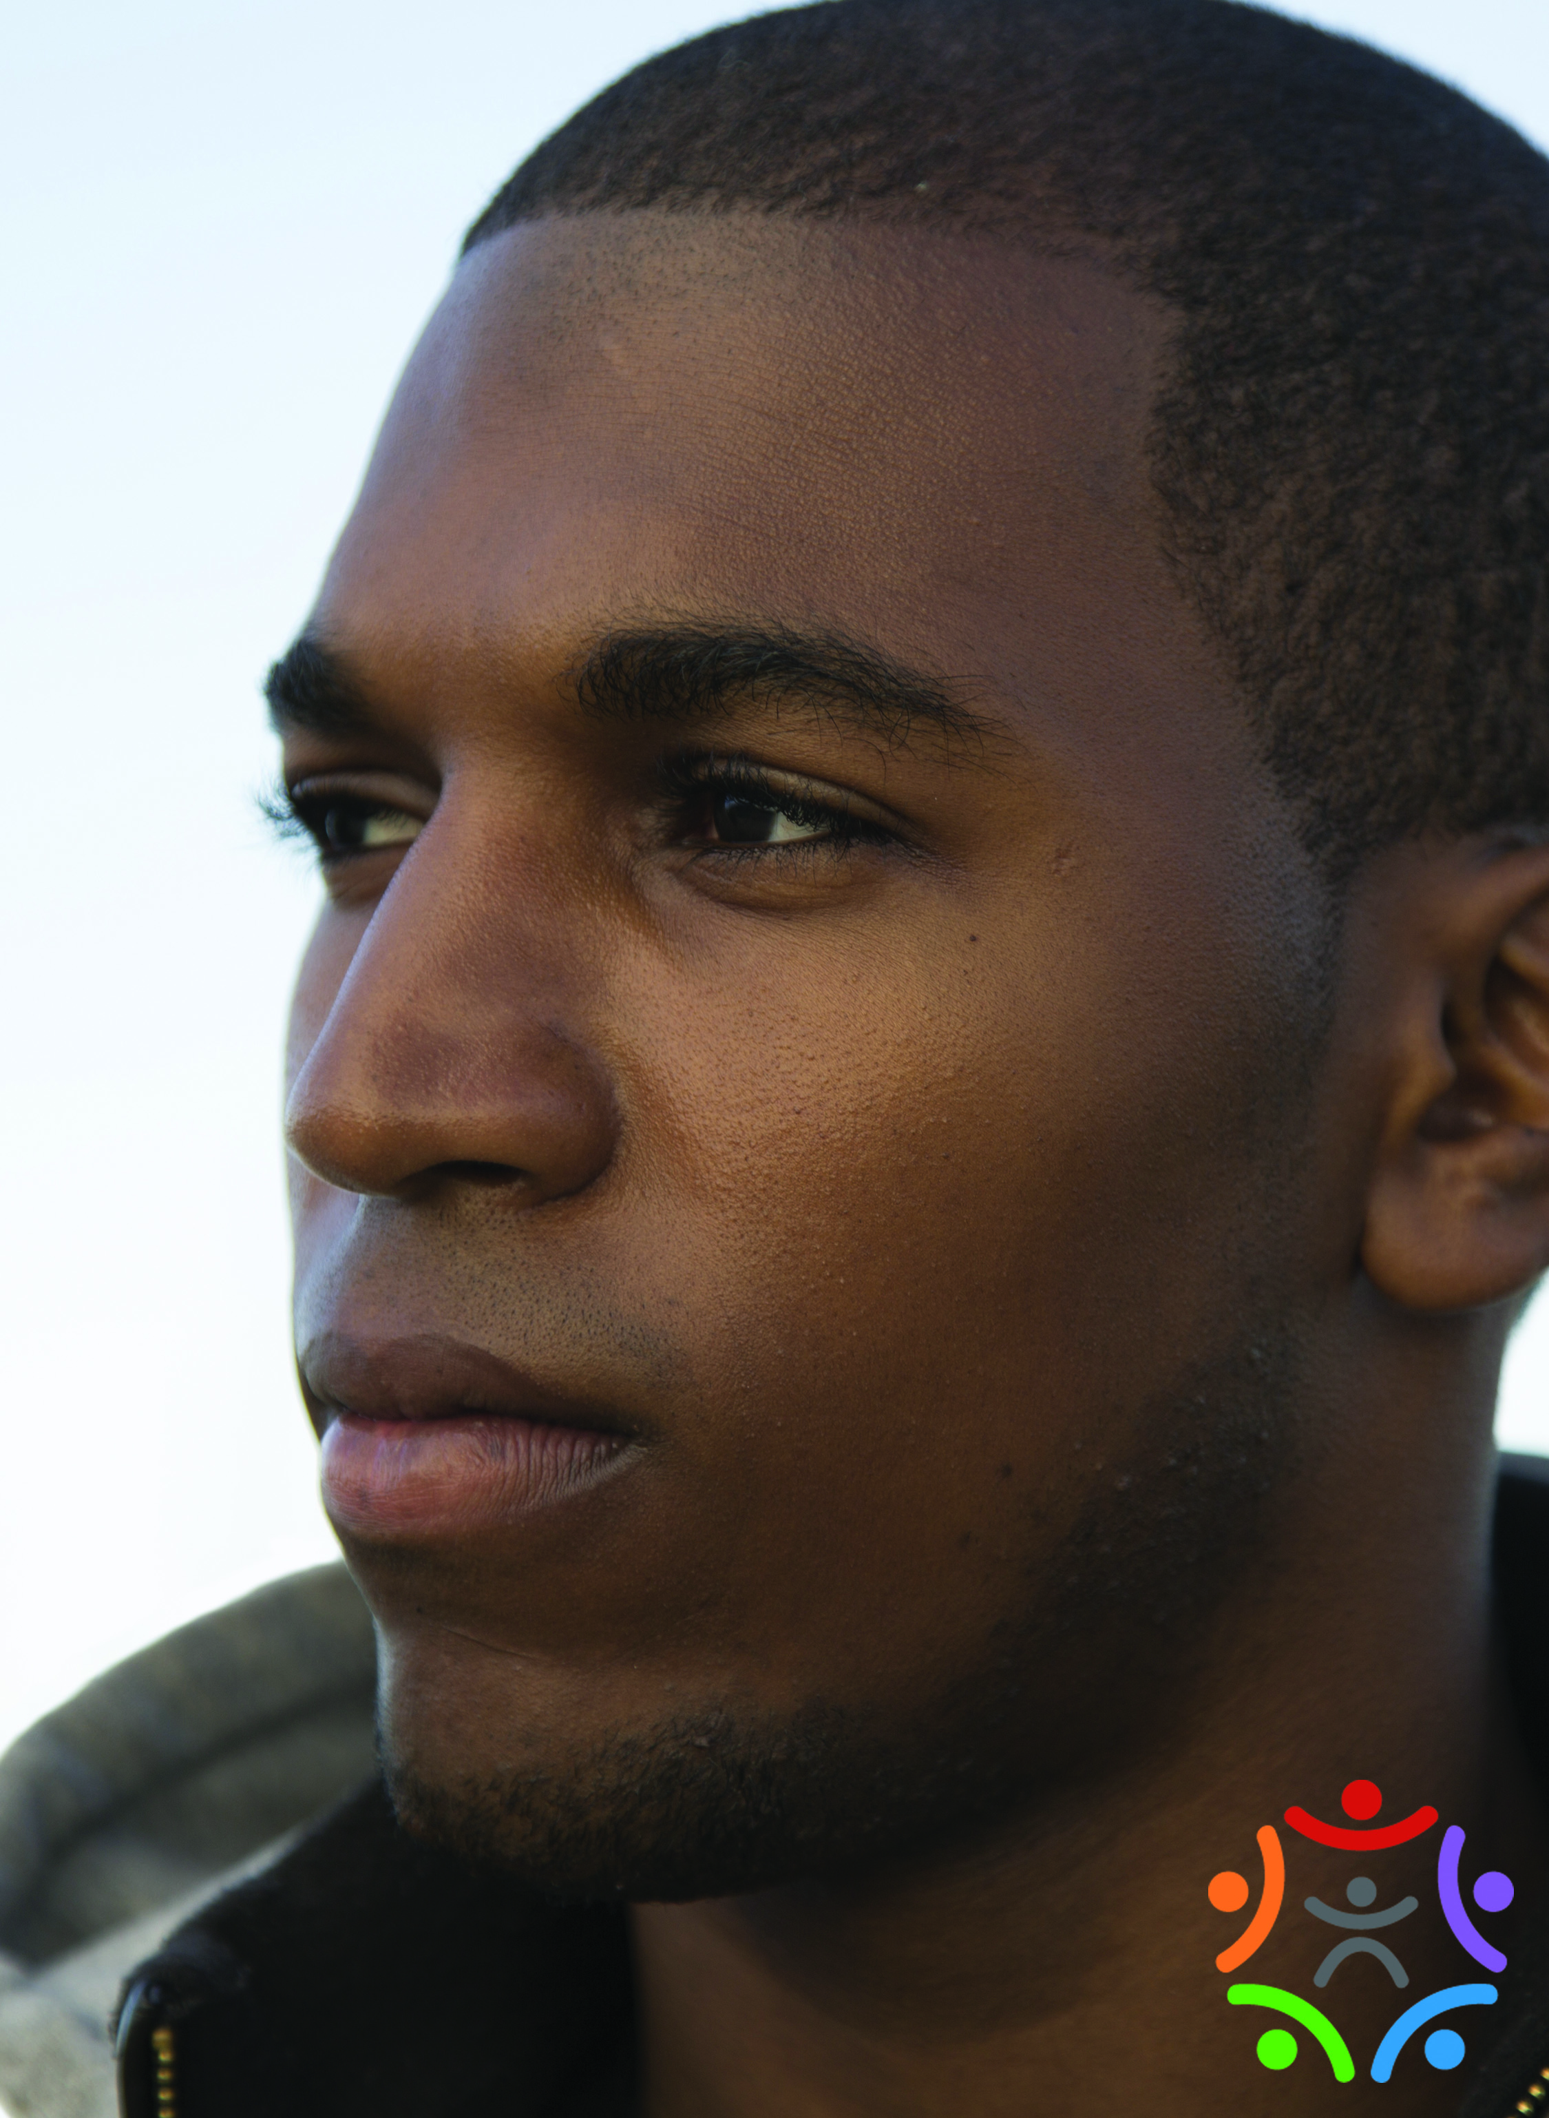
MILES 46%
Student
Part-time work
No health insurance
Tooth ache
Notes:
#1 NEED DENTAL CARE

Slide 34

NANCY 31%
Taking care of twin sister after stroke
Exhausted
Depressed
Notes:
22 SUICIDAL

Slide 35
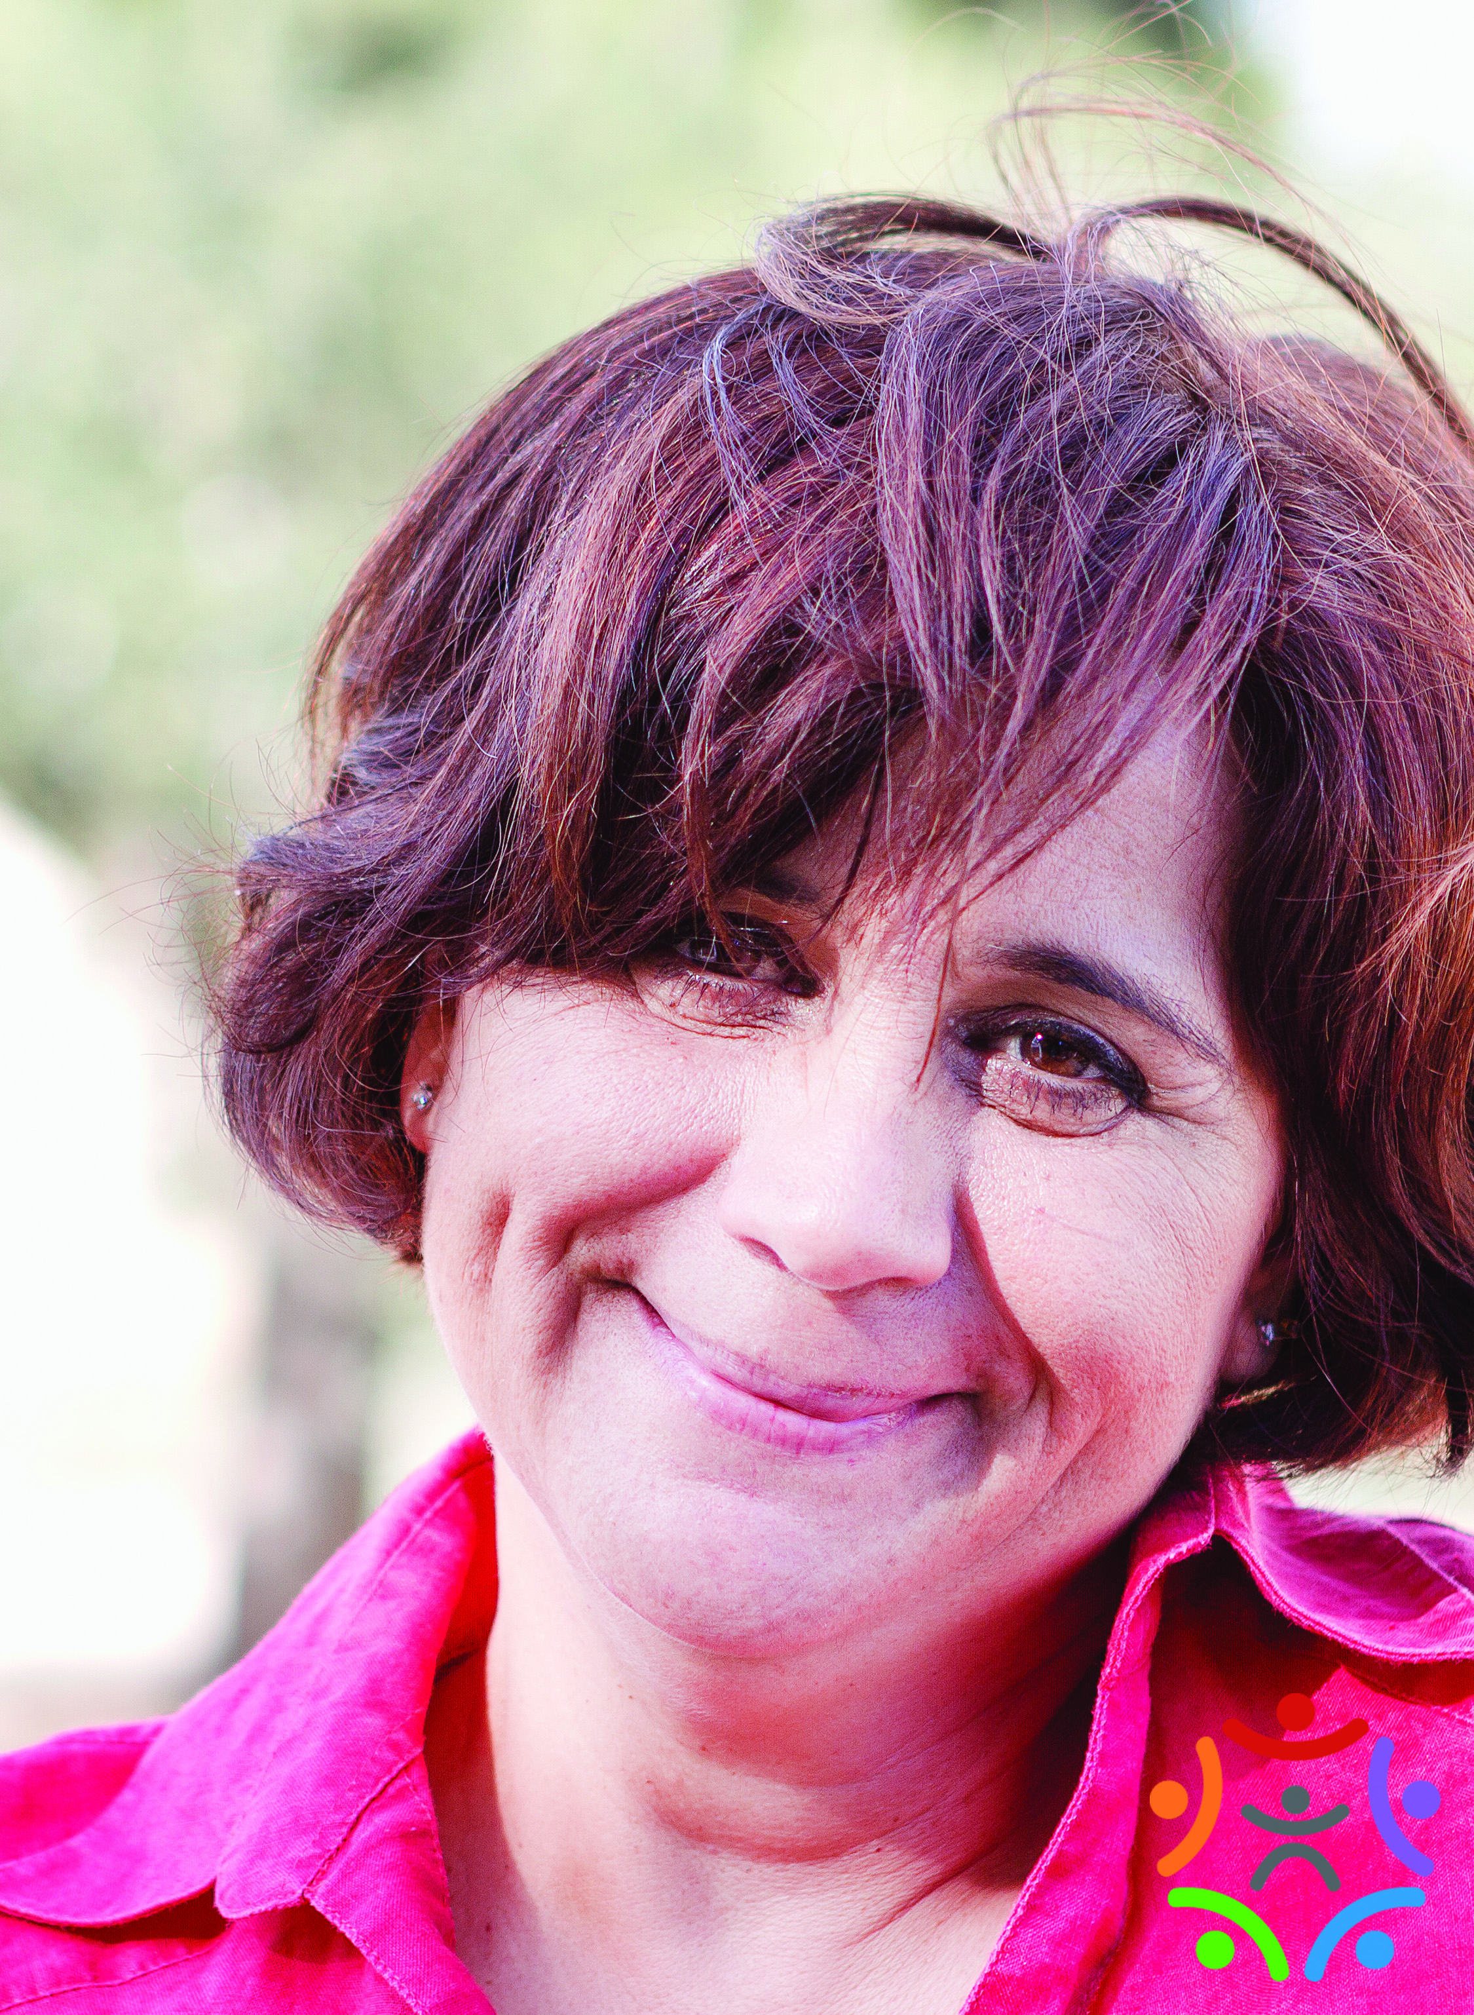
RITA 43%
Two part-time jobs
Sick 2 months ago, earned half wages & had medical expenses
Disconnect notice from TXU
Notes:
FINANCIAL WELLBEING
LIVING WAGE

Slide 36
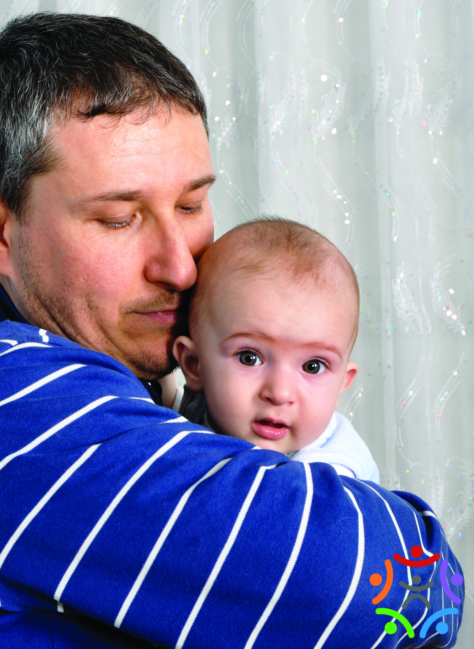
TED 31%
New job
Car broke down
No money
How will he get to work
Notes:
TRANSPORTATION

Slide 37
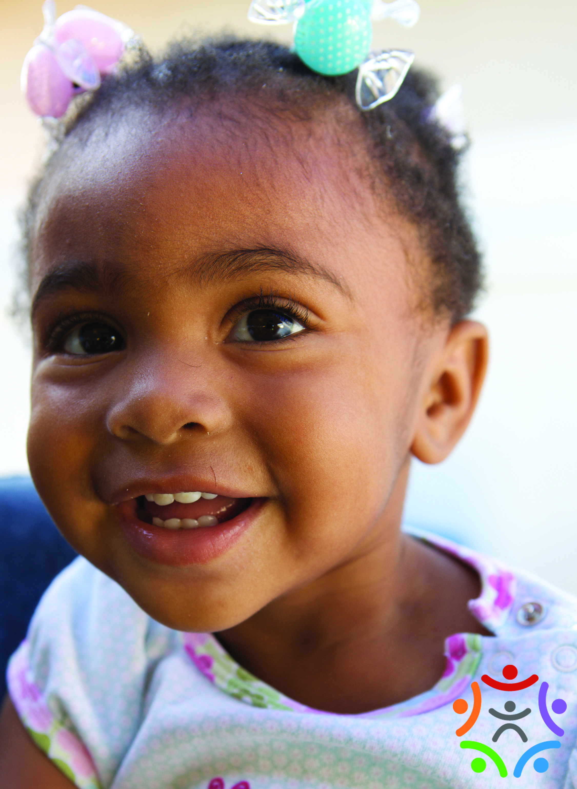
GRACIE 26%
Mom works two jobs
Neighbors babysit
Sometimes she is left by herself
No one reads to her
Notes:
26% Left children home alone
13% Use daycare centers
6% Use before and after-school programs
53% need affordable childcare
HIGH QUALITY PRESCHOOLS HAVE THE POWER TO CHABGE A CHILD’S LIFE FOREVER!
THE HECKMAN EQUATION – THE TIME WE HAVE IS SHORT
TO HELP CHILDREN WE MUST HELP FAMILIES – DUAL GENERATION APPROACH

Slide 38
Issues combine to reinforce each other and trap them in poverty, which reduces the length and quality of life, often for multiple generations.
Notes:
PRESENT CIRCUMSTANCES DON’T DETERMINE WHERE YOU CAN GO, THEY MERELY DETERMINE WHERE YOU START

Slide 39
JUST LIKE ME
Notes:
THINK OF SOMEONE WHO BRINGS JOY TO YOUR LIFE – PARENT, TEACHER, CHILD,FRIEND. CAN YOU SEE THEM?
THINK OF PEOPLE STANDING IN LINE AT A SOUP KITCHEN.
SOMEONE LOOKS FAMILIAR
NOW THINK… JUST LIKE ME, THIS PERSON…
HAS BEEN SAD
WANTS TO BE LOVED
GETS ANGRY
WANTS TO BE HEALTHY AND HAPPY
HAS MADE MISTAKES
LIKES TO LAUGH
IS TRYING TO GET WHAT THEY NEED IN LIFE

Slide 40
The human spirit is full of hope and intelligence, resilient by nature, boundless in its potential to serve the common good.
Stephen Covey

Slide 41
COLLECTIVE IMPACT
Notes:
Well on our way – early wins:
Soft skills, fafsa, dental, housing, outreach…
The way out.
Diverse organizations working together on complex social issues
Phil DeVol – Bridges to Sustainable Communities
BRIDGES OUT OF POVERTY

Slide 42
Phil E. DeVol
Getting Ahead Network

Slide 43
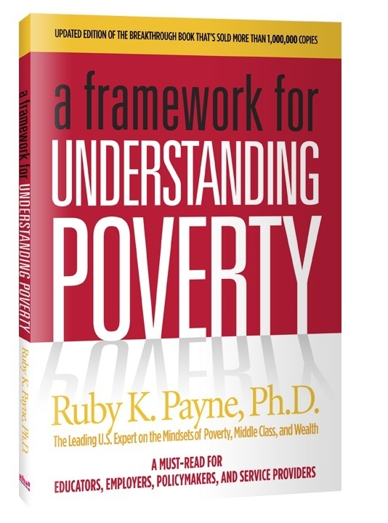
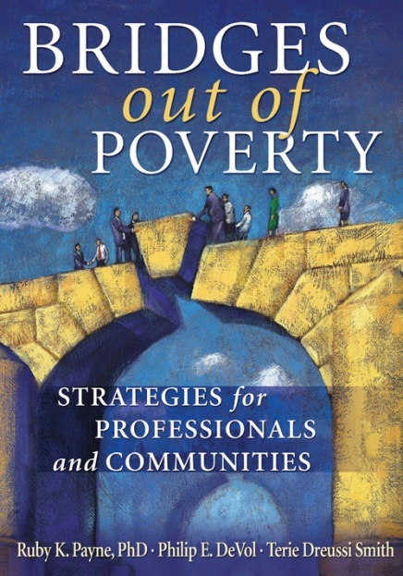
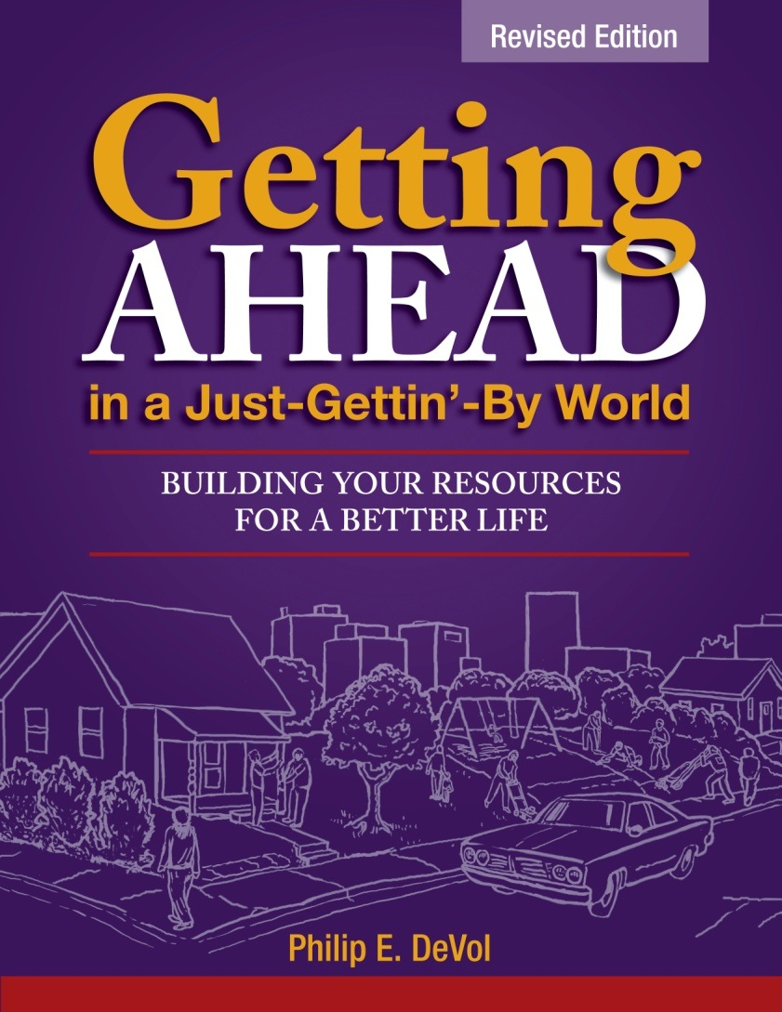
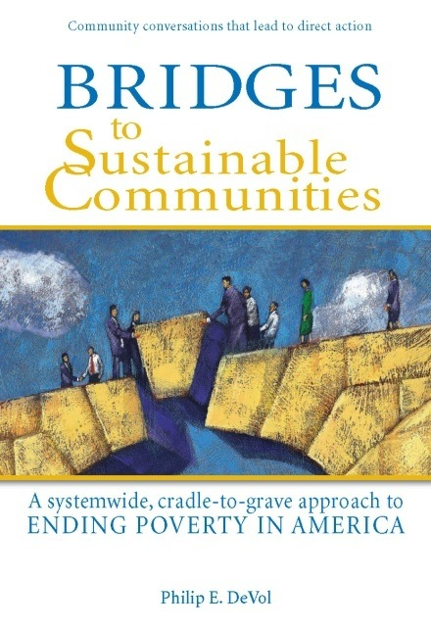
Bridges Out of Poverty and Getting Ahead in a Just-Gettin’-By World Model
------------------------------------------
Philip DeVol
12/14/2012Copyright © 2006 aha! Process, Inc. www.ahaprocess.com
1

Slide 44
Welcome to Self-Sufficiency
The Path to Self-Sufficiency Starts Here
12/14/2012Copyright © 2006 aha! Process, Inc. www.ahaprocess.com
2

Slide 45
Tracking emerging recovery in private sector
The private sector saw a net gain of 1.26 million jobs between
February 2010 and 2011. During the same period the public sector
lost almost a quarter of a million jobs.
 | Wages | Percent of job loss | Percent of recent job growth
Lower-wage Industries | $9.03 - $12.91 | 23% | 49%
Mid-wage industries | $12.92 - $19.04 | 36% | 37%
Higher-wage industries | $19.05 - $31.40 | 40% | 14%
NELP National Employment Law Project, Data Brief, February 2011
www.nelp.org/page/./Justice/2011/UnbalancedGrowthFeb2011.pdf?nocdn=1
12/14/2012Copyright © 2006 aha! Process, Inc. www.ahaprocess.com
5

Slide 46

The Bridges Model is not a program
People and organizations use Bridges to develop programs and strategies that:
  Improve relationships at the individual level.
  Improve outcomes at the organizational level.
  Change systems at the community level.
Bridges helps:
  Prevent poverty.
  Alleviate suffering.
  Support people in transition.
  Eliminate poverty.
12/14/2012Copyright © 2006 aha! Process, Inc. www.ahaprocess.com
13
Notes:
A Community of Practice existed before we recognized it, as is often the case.
One of the first innovators was Cascade Engineering.
Bridges can be applied in almost any community or organization because it is not a program. It is always local and relevant.
Use video clips from the website to illustrate these and other slides.

Slide 47
Seat all Classes at the Planning
and Decision Making Tables
Poverty
Middle Class
Solving
problems
Building
resources
Wealth
Module 10
Copyright 2006. Revised 2011. DeVol & Associates LLC. All rights reserved. www.ahaprocess.com
Notes:
This mental model simply illustrates that Bridges Communities and Guiding Coalitions want and need people from all classes at the decision making table. This helps build a future story for Getting Ahead graduates who want to participate.
Getting Ahead Investigators and graduates provide a great deal of crucial information to those who are at the table with them:
An accurate mental model of poverty in the community; concrete, local, timely information.
An assessment of the community from the point of view of people who are generally not heard or seen.
Information about the barriers faced by the people who are transitioning out of poverty.

Slide 48
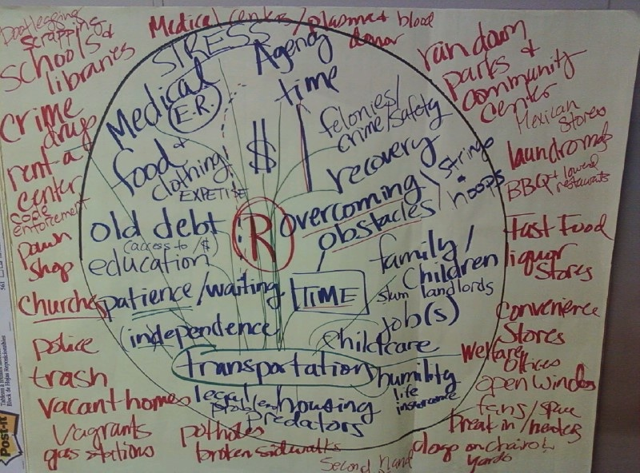
Mental Model of Poverty
South Bend, Indiana
12/14/2012Copyright © 2006 aha! Process, Inc. www.ahaprocess.com
20

Slide 49
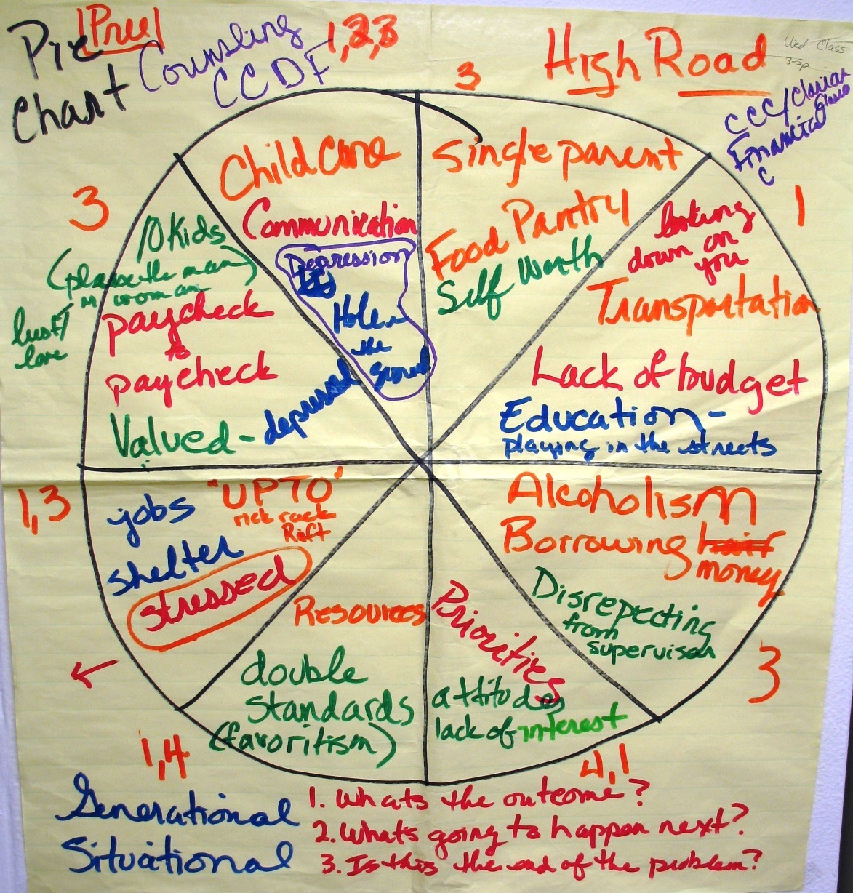
Clarian Health Partners
Indianapolis, Indiana
Copyright 2012 by DeVol & Associates, LLC. All rights reserved. www.gettingaheadnetwork.com
Notes:
Example from Clarion Health Partners in Indianapolis

Slide 50
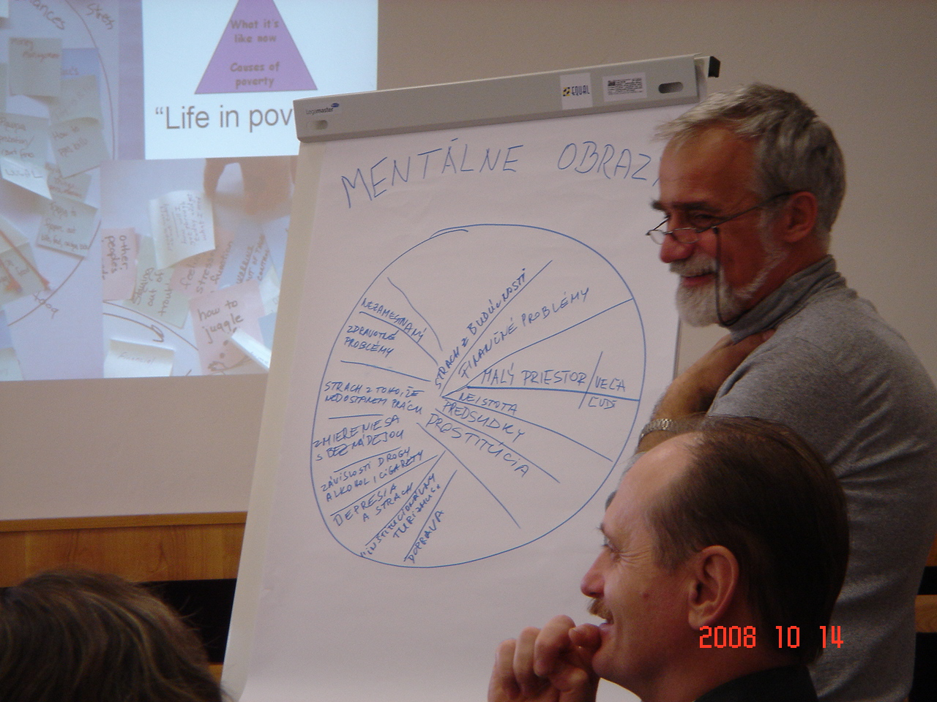
Košice, Slovakia
Copyright 2012 by DeVol & Associates, LLC. All rights reserved. www.gettingaheadnetwork.com
Notes:
Example from Koscie Slovakia

Slide 51

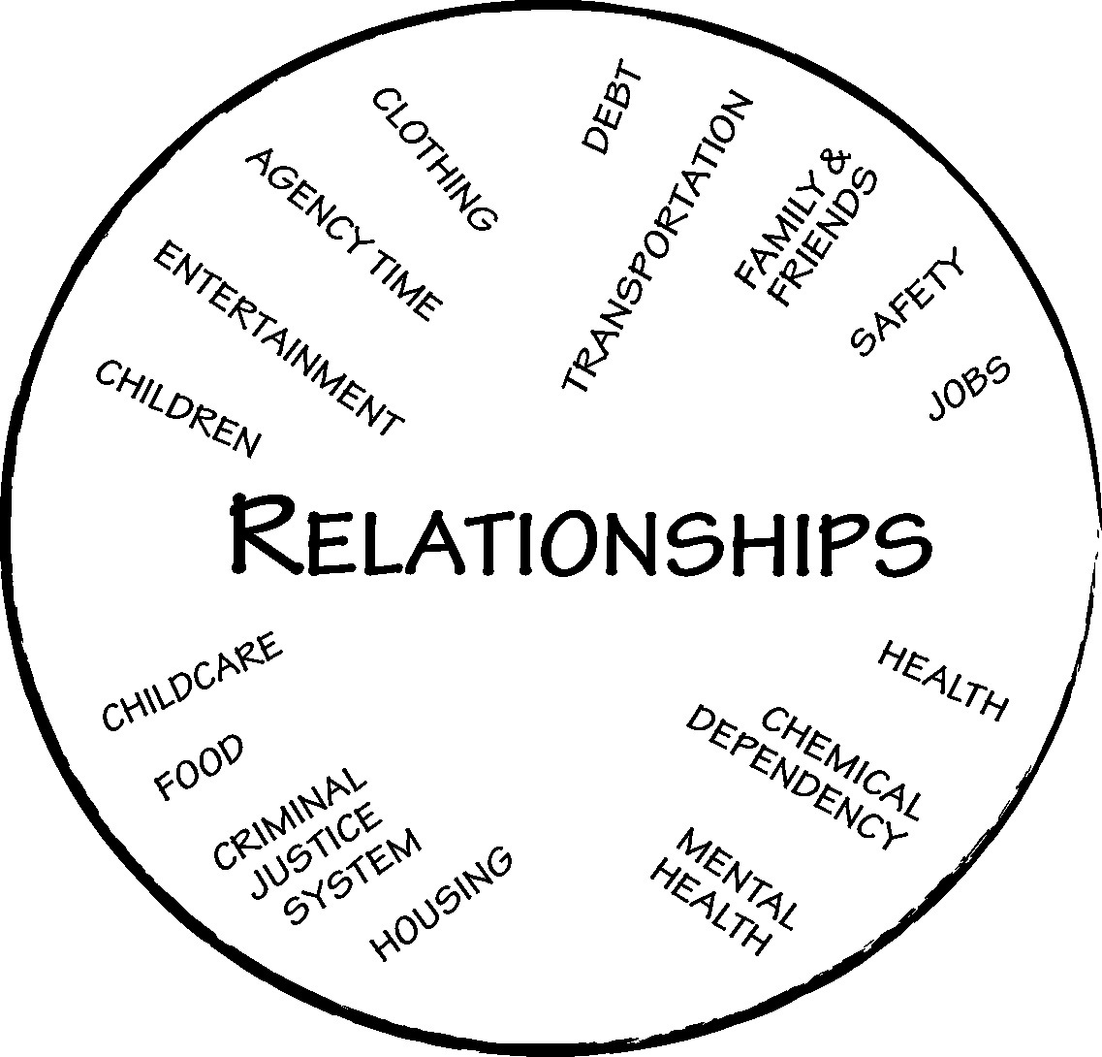
Mental Model of Poverty
Developed by Phil DeVol (2006)
Notes:
Slides 15–19:
Spend most of the time you have to develop the mental model of poverty, then use Slide 18 to compare and contrast the three environments. Slide 19 is to honor the other lens (diversity) and establish that Bridges has to be done locally; poverty plays out differently in every community.

Slide 52
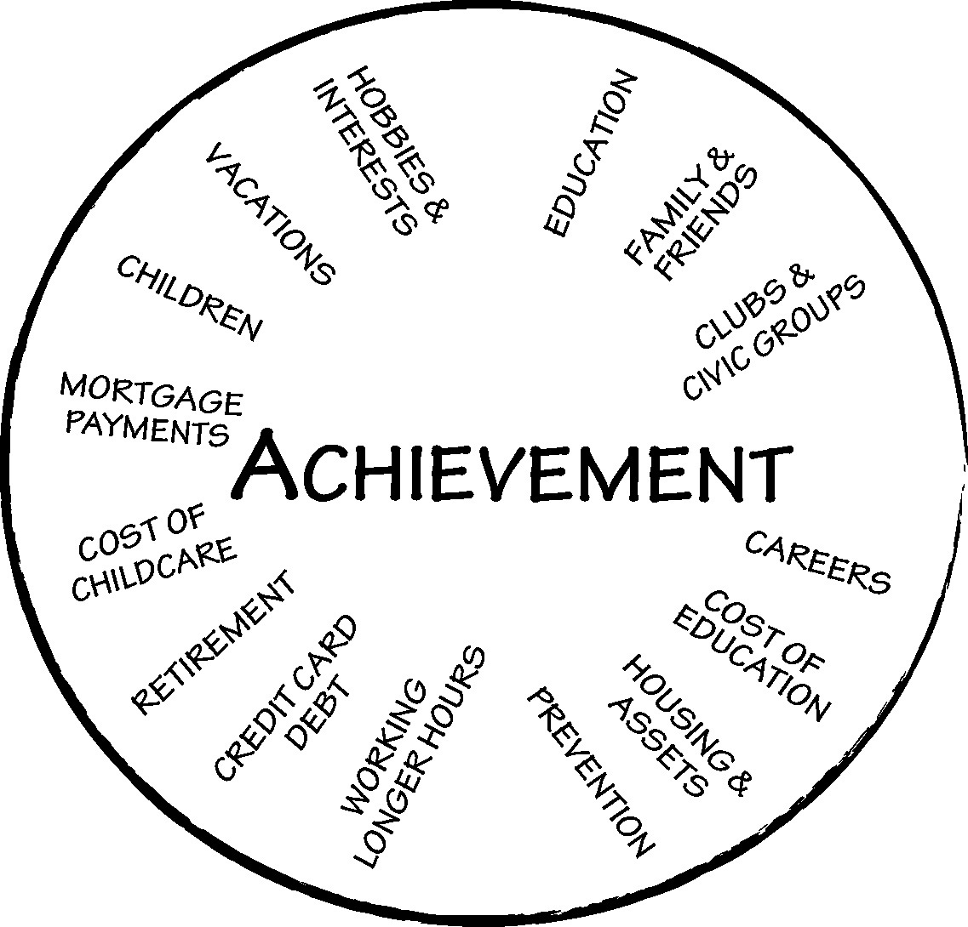
Mental Model of Middle Class
Developed by Phil DeVol (2006)
Notes:
Add elements to the mental model: mortgage payments, working longer hours, credit card debt, cost of education, cost of childcare.
“Where Did They Go? The Decline of Middle-Income Neighborhoods in Metropolitan America.” http://www.brookings.edu/research/reports/2006/06/poverty-booza
What has happened to middle class areas in the center of the country?
Exercise: What has happened to the middle class in your community in the past five years?
What would you add to the Mental Model of Middle Class to fit your community more accurately?

Slide 53
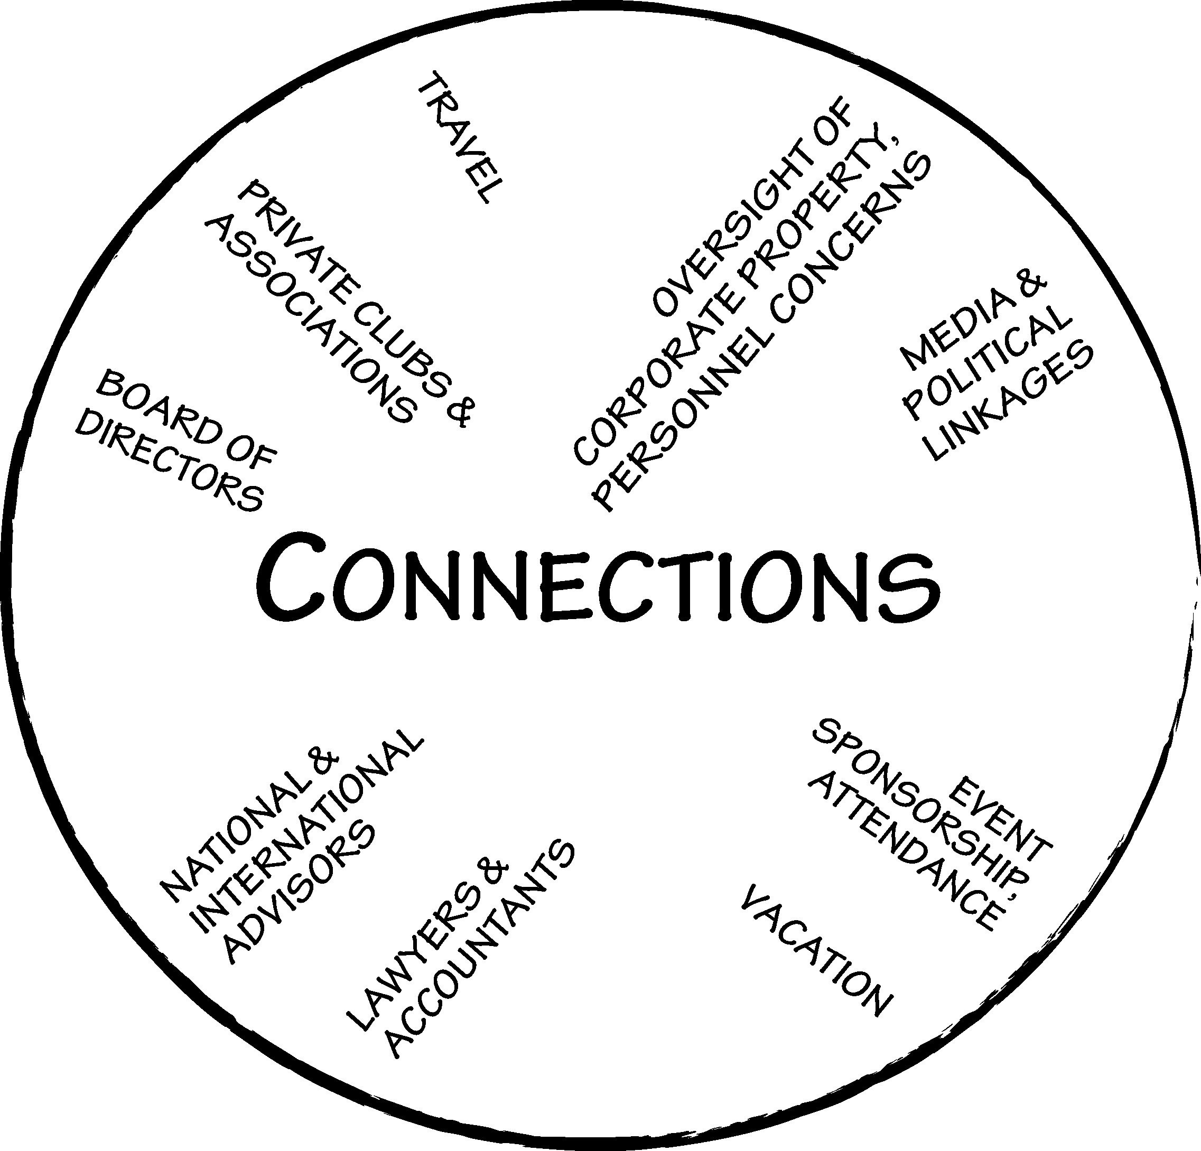
Mental Model of Wealth
Developed by Ruby Payne (2005)
Notes:
This mental model is provided so that the audience can see where the hidden rules of class, including the wealthy class, come from.
Analyze this mental model for stability, time horizon, problem solving strategies, and power.
The environment of poverty is unstable, so people have to focus on solving immediate, concrete problems. The environment of middle class is more stable; because people have today covered, they worry about the future and focus on planning. The environment of wealth is so stable that people don’t worry about today or tomorrow; they can make decisions based on family traditions.
The time horizon in poverty is the present. The time horizon in middle class is 2–4 years; people can make plans 2–4 years in advance and reasonably expect to see them through. The time horizon in wealth is two decades.
People in poverty have personal power, strength, and fighting ability, but they may not have the power to stop bad things from happening in the neighborhood or community. People in middle class have the power of the institutions because the institutions are run on middle class rules and norms. People in wealth have the power to influence and shape policy and the direction of the community.
REINFORCEMENT:
These concepts will appear in the hidden rules and again in the module on poverty research. Our point is that to create sustainable communities, we must have all three classes at the table. It helps greatly if we understand one another’s environments and hidden rules.

Slide 54

Mental Model of Poverty
Concrete information inside the circle; analytical categories outside
Tyranny of the moment,
Time horizon
Concrete,
Abstract
Reactive problem-solving,
Proactive problem-solving
Powerless,
Powerful
Math doesn’t work,
Financial security
Unstable,
Predictable
Developed by Phil DeVol (2006)
Notes:
This mental model was first created by a group of people in poverty in central Ohio. This model would be somewhat different by region, race, ethnicity, and cultural history, but it has common features that appear in all situations.
It’s important to learn to analyze poverty situations for stability, time horizon, and problem solving strategies.
Beware of making judgments—this is about gaining understanding.

Slide 55
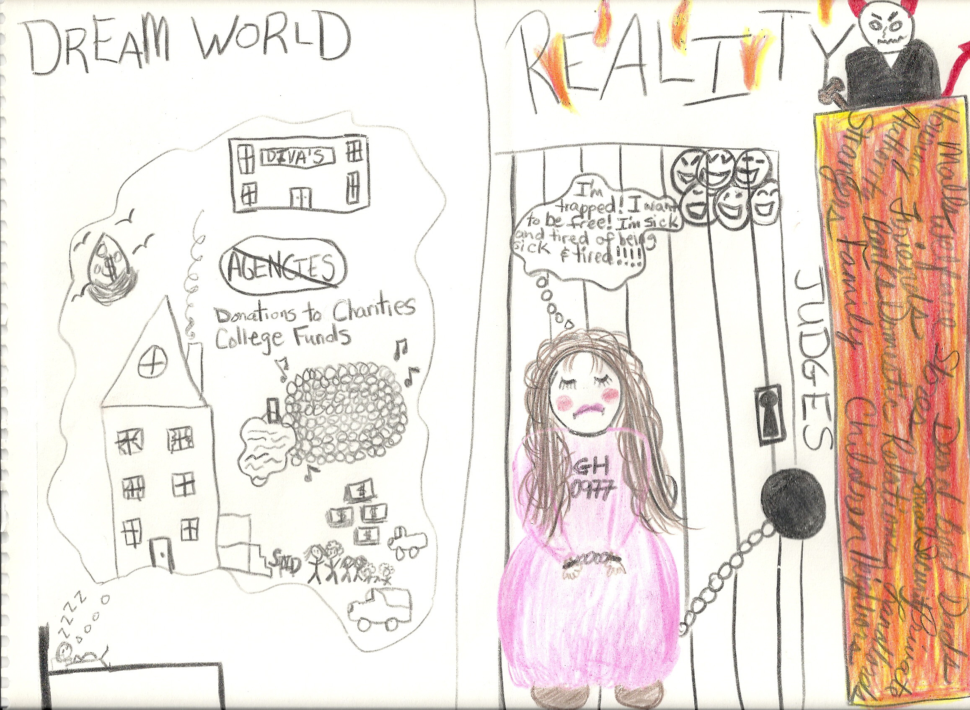
12/14/2012Copyright © 2006 aha! Process, Inc. www.ahaprocess.com
24

Slide 56
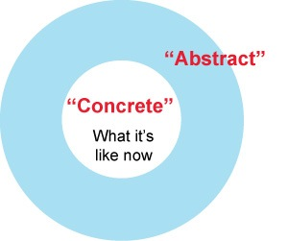
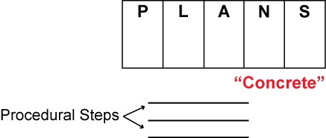
Overcoming the Tyranny of the Moment, the Scarcity Mindset
Theory of Change
Detachment
Objectivity
Analysis
Thinking
New ideas
New information
Education
Plans
Support
Notes:
Sharing the process of change with investigators is respectful, and it can be the freeing agent of this work. The thing that frees them from being stuck in poverty can be the choice to go to the abstract, to think, in the midst of chaos.
The red arrow symbolizes what happens in the tyranny of the moment. You’re stuck in the concrete reality, a problem happens, you react, you solve the problem, you remain stuck, the same problem recurs, you solve it the same way, and nothing changes. It’s about moving from the concrete problem to a concrete solution. It is reactive problem solving. It’s a great skill and one that is necessary for civilian populations in war, victims of natural disasters, and people living in persistent and concentrated poverty. It should be honored, but it’s unlikely to bring about new solutions that move a person to a stable environment.
The blue arrow symbolizes what the process of change is that underlies this work. A problem occurs within the context of the concrete reality. You pause and consider new, abstract information and how it might be applied. You come up with a plan that solves the problem in a new way, perhaps eliminating it or at least reducing the likelihood that it will recur.
No matter what, the plans need to be concrete, with clear, specific steps.
Writers from many disciplines and fields who influenced this work:

Slide 57
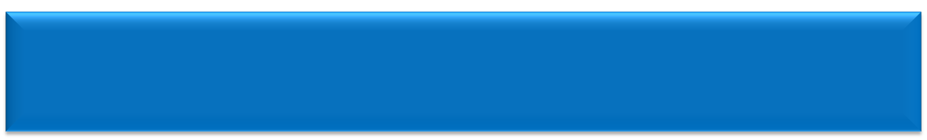
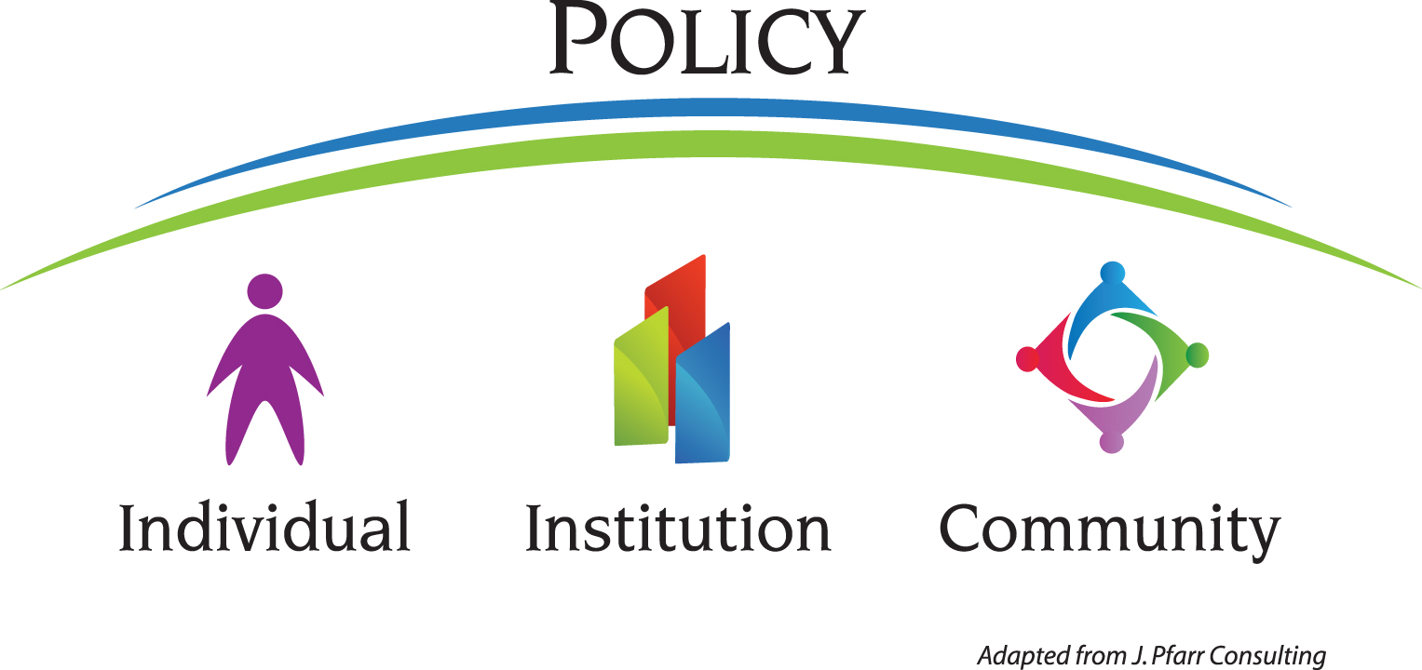
Viewing Economic Class issues through the“Triple Lens”
Copyright J. Pfarr Consulting
Copyright www.bridgesoutofpoverty.com

Slide 58
Poverty is the extent to which we do without resources:
Hidden Rules
Support System
Relationships
Financial
Emotional
Spiritual
Physical
Integrity
Motivation
Mental
5
4
3
2
1
12/14/2012Copyright © 2006 aha! Process, Inc. www.ahaprocess.com
32
Notes:
Module 8 – Self Assessment Regarding Resources
Key Points:
This mental model summarizes the hard work of doing a self assessment.
It show us where our strengths are and which resources need to built up.
This is from Kim Wilt, Springfield Ohio. She said that after doing this she wept for twenty minutes. When she went into the restroom her motivation was a one, when she came out it was a four. She said, “Until then I didn’t realize that it was my job to build my own resources, or that I could build the resources of my children.”

Slide 59

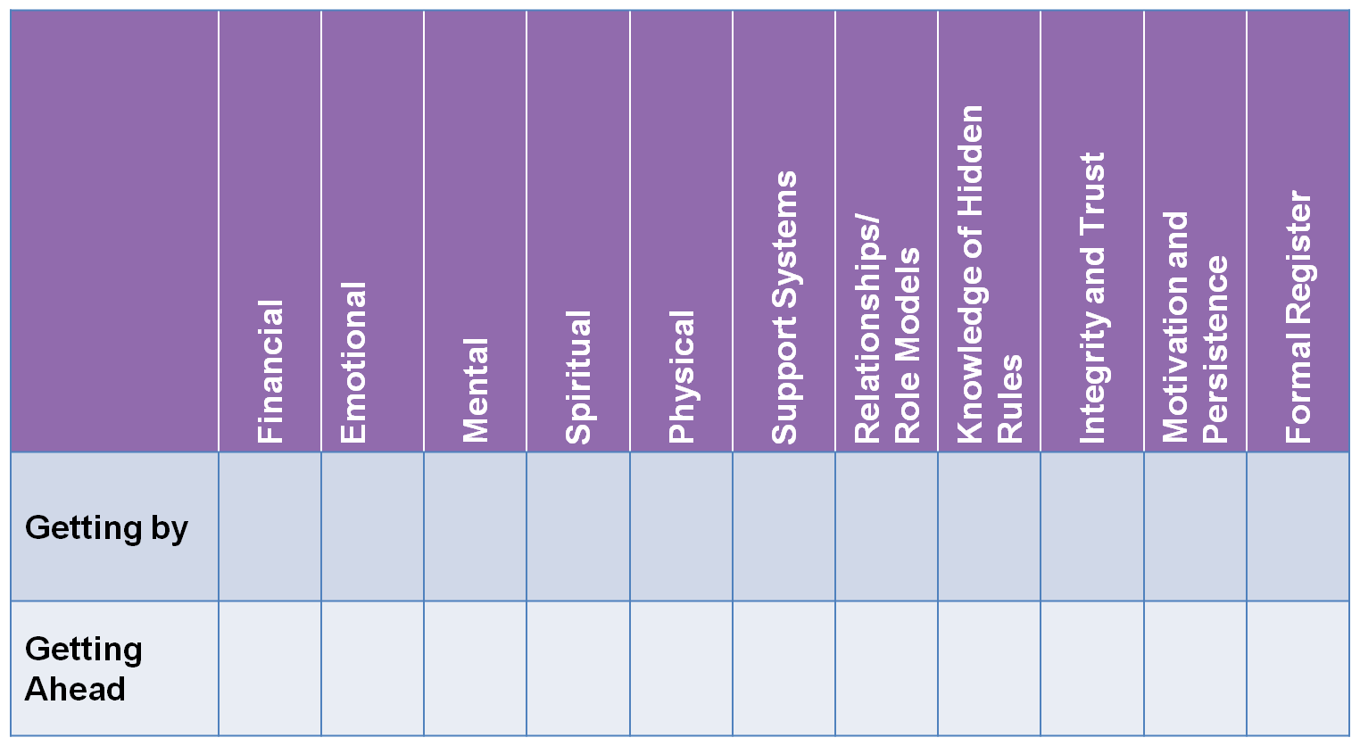
RESOURCES
Reprinted with permission. Copyright J. Pfarr Consulting.
12/14/2012Copyright © 2006 aha! Process, Inc. www.ahaprocess.com
71
Notes:
Have the institution complete the grid. Regarding financial resources, list the programs that bring those resources to the participant and which ones help build them. For example, a program that just gives participants money would be listed under “brought.” A program that compensates participants as they educate themselves on financial matters and supports them by lobbying for livable wages would be listed under “builds.” If an institution does not address financial resources, leave it blank. If an institution collaborates with (not partnerships but collaborates with) another institution to address financial resources, then write that collaboration in that box. This grid will show clearly which resources an institution addresses and how they address it. Ideally you would want all the resources to be addressed in the “building” line either by collaboration or directly by your institution.

Slide 60

Bridges Continuum
A Comprehensive Planning Tool for Bridges Steering Committees
 | Preconception to 6 | K–12 | Post-Secondary | Workforce Placement | Job Retention | Self-Sufficient Wage | Seniors | Wellness | Community Prosperity
Metrics
Fallout Costs
Bridges Strategies
Responsible for Action
Address poverty at every stage of life.
Engage all sectors.
Notes:
The most recent version of the Bridges continuum can be found in the Facilitator Notes for Getting Ahead on pages 30 and 31.
The Bridges continuum features these concepts:
Poverty can be addressed at every stage of life.
Almost every sector can participate in stabilizing the environment and building resources.
Community metrics must be identified to set reasonable goals and to serve the purpose of each organization.
Some people are drawn to Bridges by their hearts, others by their heads. They need to see numbers. Poverty is costly; it’s not a good economic model.
Identify the solutions offered by aha! Process and the Bridges community of practice.
Successful approaches in one sector often can be adapted to improve outcomes in another sector. For example, employers have created strategies to improve retention rates that can be adapted by colleges to improve their graduation rates.
This tool illustrates how most organizations can be responsible for doing something to address poverty.
Bridges can prevent poverty, alleviate suffering, and support people in transition.
How to use the tool:
Share this tool at all trainings; it will help people see how they can fit into the Bridges work
To attract people in all sectors
To illustrate what each sector can do and how it will benefit by joining the initiative
To illustrate the need for collaboration
Create a local version of this table

Slide 61
Community Sustainability Grid
A Comprehensive Planning Tool for Bridges Steering Committees
Name the Barrier: Work one barrier at a time. | Individual Behavior | Human and Social Capital in the Community | Exploitation | Political/ Economic Structures
Individual Action
Organizational Action
Community Action
Policy
Address All Causes of Poverty,
Engage All Political Persuasions
Notes:
The four causes of poverty—providing another key component of the Bridges language. Illustrate how people from all political persuasions participate in Bridges initiatives.
Establish that we address all causes of poverty by taking action at four levels: individual, etc.
Establish that this allows people of all political views to work together well at the table if people can lighten up on their favorite point of view enough to recognize that there is good research on all causes of poverty and that community discourse doesn’t have to follow talk radio and cable television, or think-tank fodder (smile), with the either/or thinking but with both/and thinking and action. Listen to people in poverty, and you’ll find out what the barriers are in poverty. You’ll also figure out how to build concrete resources and solutions.

Slide 62
Business and Workforce Development
Community of Practice
Cascade Engineering
Grand Rapids, MI
Working Bridges
Burlington, VT
Future Story Project
South Bend, IN
The Source
Grand Rapids, MI
WorkLife Partnership
Denver, CO
Cincinnati Works
Cincinnati, OH
Clarian Health Systems
Indianapolis, IN
Vectren Corporation
Evansville, IN
Goodwill’s Good Signs for Getting Ahead
Indianapolis, IN
12/14/2012Copyright © 2006 aha! Process, Inc. www.ahaprocess.com
8
Notes:
It’s important to establish an accurate mental model of what instability looks like in your business and community.
This activity will lead us to more of a common understanding of what it is like for employees and families living with instability, especially where resources are low.
This module uses a co-investigative process, not a “telling” approach.

Slide 63

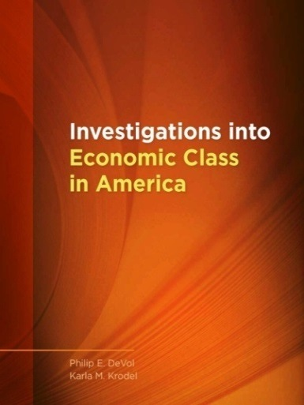
Postsecondary
Community of Practice
Arkansas Department of Higher Education Danville Area Community College, Danville, IL Fresno City College, Fresno, CA Hutchinson Community College, Hutchinson, KS Ivy Tech Community Colleges, IN Kent State University, Salem, OH Lansing Community College, Lansing, MI Lynchburg College, Lynchburg, VA NW Louisiana Technical College, Minden, LA Ohio Campus Compact, OH | Peru State College, Peru, NE Riverside Community College District, Riverside, CA Southwestern Oregon Community College, Coos Bay, OR Sussex County Community College, Newton, NJ Trinidad State Junior College, Trinidad, CO University of Florida, Gainesville, FL Walla Walla Community College, Walla Walla, WA Youngstown State University, Youngstown, OH Zane State College, Zanesville, OH
Notes:
Slides 7–12:
Establish that Bridges concepts are being used effectively by various sectors, stopping to tell stories about Cascade Engineering (9) and Youngstown State University (12). Provide other evidence of success as you see fit.
Establish that the organizations in these sectors form a learning community or community of practice.

Slide 64
Courts and Criminal Justice System
Community of Practice
Ohio’s 4 year, 4 phase Initiative:
  Columbiana County Municipal Court
  Marion Municipal Court
  Montgomery County Juvenile Court
  Clermont County Municipal Court
Allen County Superior Court, Indiana, Judge Charles Pratt
Orange County, Vermont, Assistant Judge Prudence Pease
Oklahoma Reentry Programs
Dixon Correctional Facility, Baton Rouge, LA
NE Colorado Jails and Prisons
12/14/2012Copyright © 2006 aha! Process, Inc. www.ahaprocess.com
10

Slide 65

Getting Ahead Community of Practice
Bartlesville, OK | Inkster, MI | Presov, Slovakia
Baton Rouge, LA | Lewiston, ID | Riverside, CA
Billings, MT | Lisbon, OH | Salem, OH
Boulder, CO | Marshall, MO | Salina, KS
Bucks County, PA | Menominee Nation, WI | Schenectady, NY
Burlington, VT | Minneapolis, MN | South Bend, IN
Columbus, OH | Newark, OH | Springfield, OH
Evansville, IN | Newton, KS | Sterling, CO
Farmington, NM | Newton, NJ | Syracuse, NY
Gettysburg, PA | Owen Sound, Ontario | Toledo, OH
Indianapolis, IN | Pensacola, FL | Youngstown, OH
Notes:
There are more than 200 sites where Getting Ahead (GA) is being used in communities that are prosperous and poor, rural and urban, in every region of the U.S., in Canada, Australia, and in Slovakia. By sharing their experiences with Getting Ahead facilitators and sponsors, investigators have formed a community of practice. The community of practice provides supports to new sponsors and facilitators.

Slide 66


Youngstown State University
Health Care Career Pathway Initiative for low-wage workers funded by the KnowledgeWorks Foundation
Professional development for hospital staff and regional education providers
Used Getting Ahead as entry point to career pathway
  Full-time employment increased from 31% to 76%
  Of the 312 enrolled, 58% continued on to additional postsecondary education

Slide 67
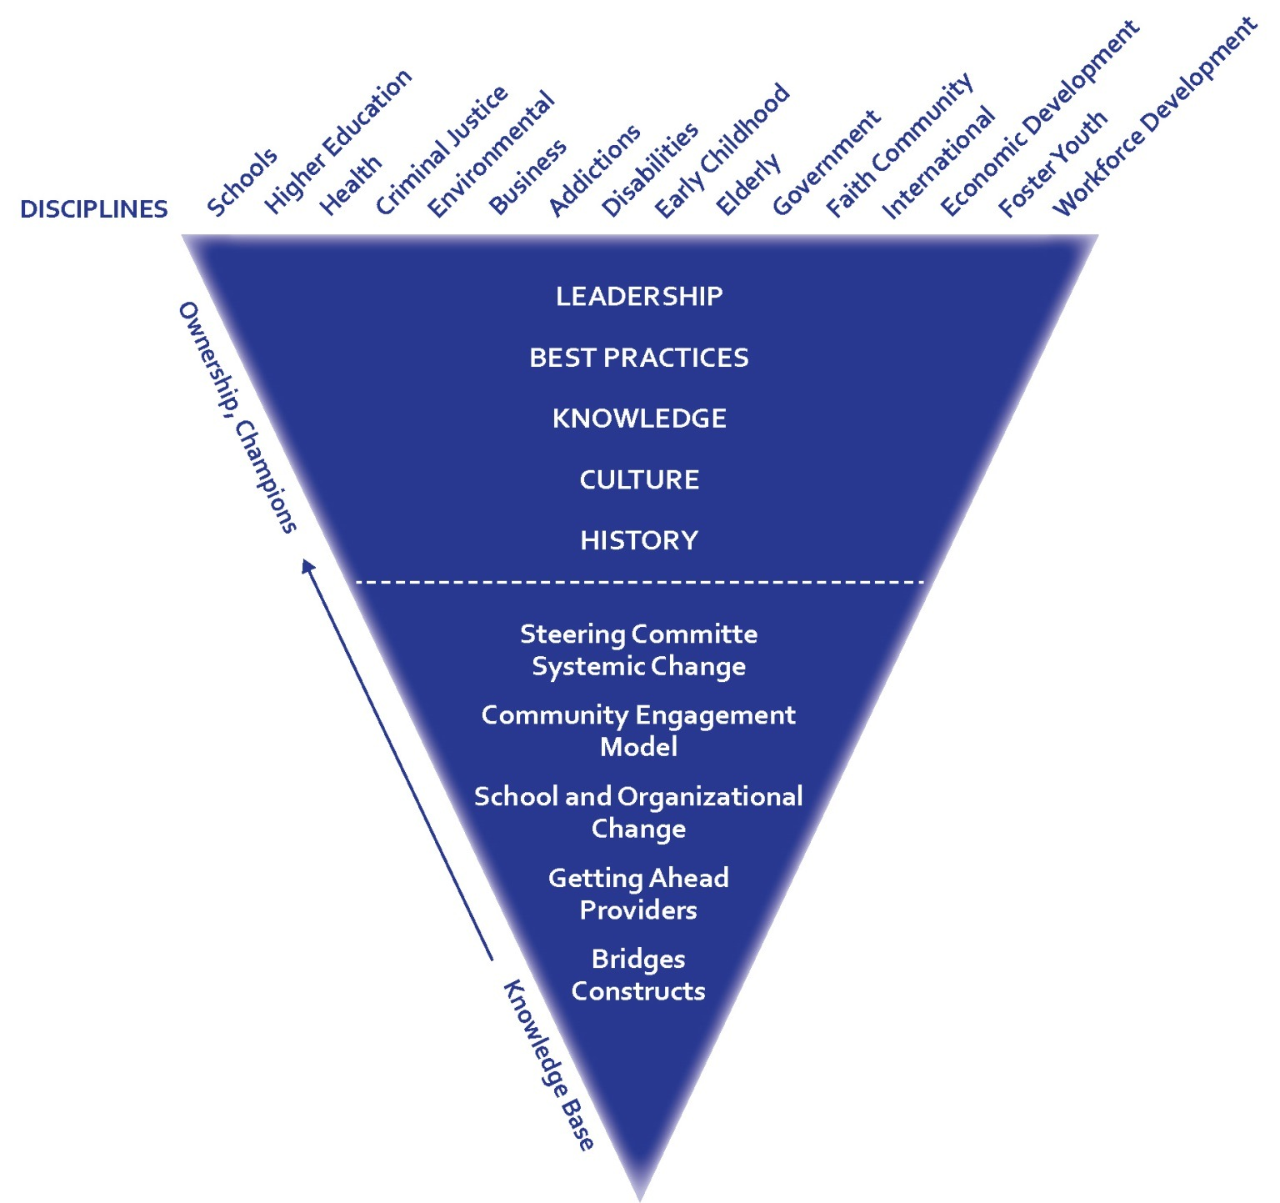
Methodology: Innovation
Notes:
How to use the tool:
Bridges provides the basic concepts and some programs that appear under the dotted line in the mental model.
Those who apply the concepts naturally take into account the history, culture, knowledge base, leadership, and best practices of their organization, community, or discipline. Judge Carol Robb made nine policy changes in her court that not only saved the county money but helped stabilize the lives of the offenders. The simplest change was to switch from specific probation appointment times for offenders to setting a day and time by which the meeting with the probation officer was to take place. This saved the county the cost of issuing bench warrants and stabilized the lives of offenders by keeping them out of jail. Several courts in Ohio and elsewhere have adopted this strategy.
The solutions that arise from this methodology will be relevant and sustainable. Adopting this thinking tool can open the door to the expansion of Bridges into many more disciplines and sectors.

Slide 68

“Innovators are
often not the
principal agents
of change; early adapters are.”
–Michael Fairbanks
Notes:
End Bridges presentations by encouraging listeners to be early adapters, to own the Bridges concepts to the degree that they can quickly move from novice to expert and become innovators. We want to help people see a future story for themselves in the Bridges movement.

Slide 69
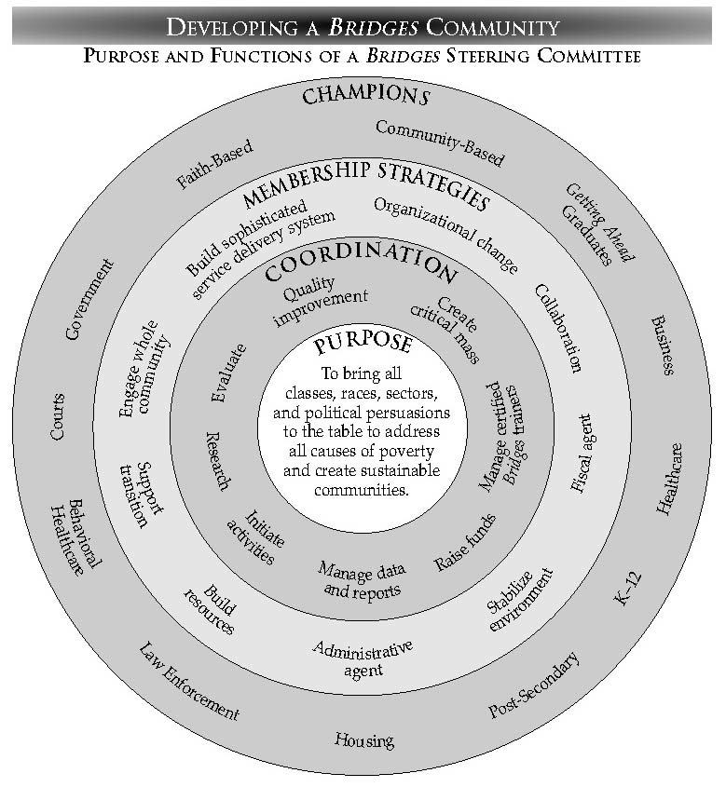
Bridges Steering Committees

Slide 70
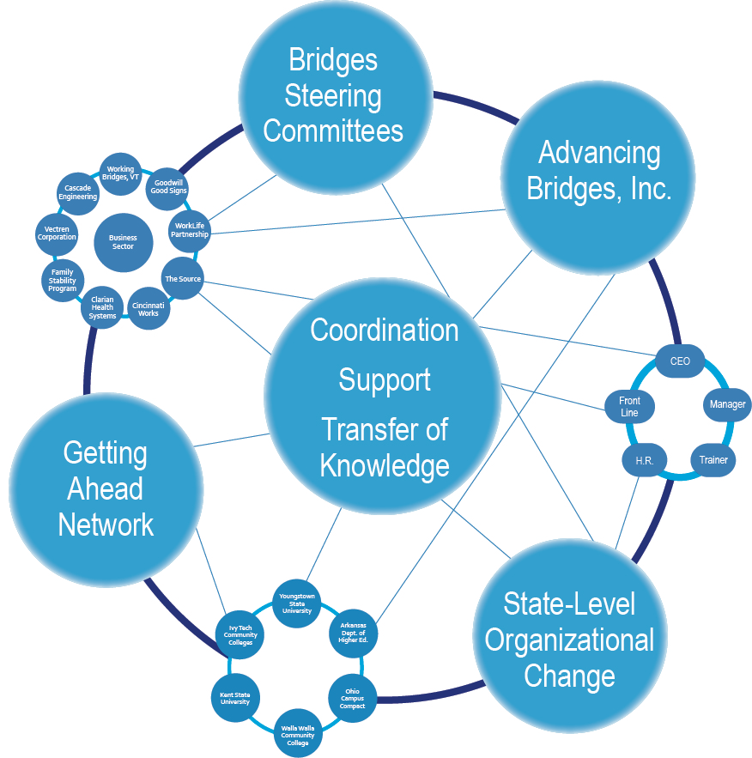
National Bridges Community of Practice

Slide 71
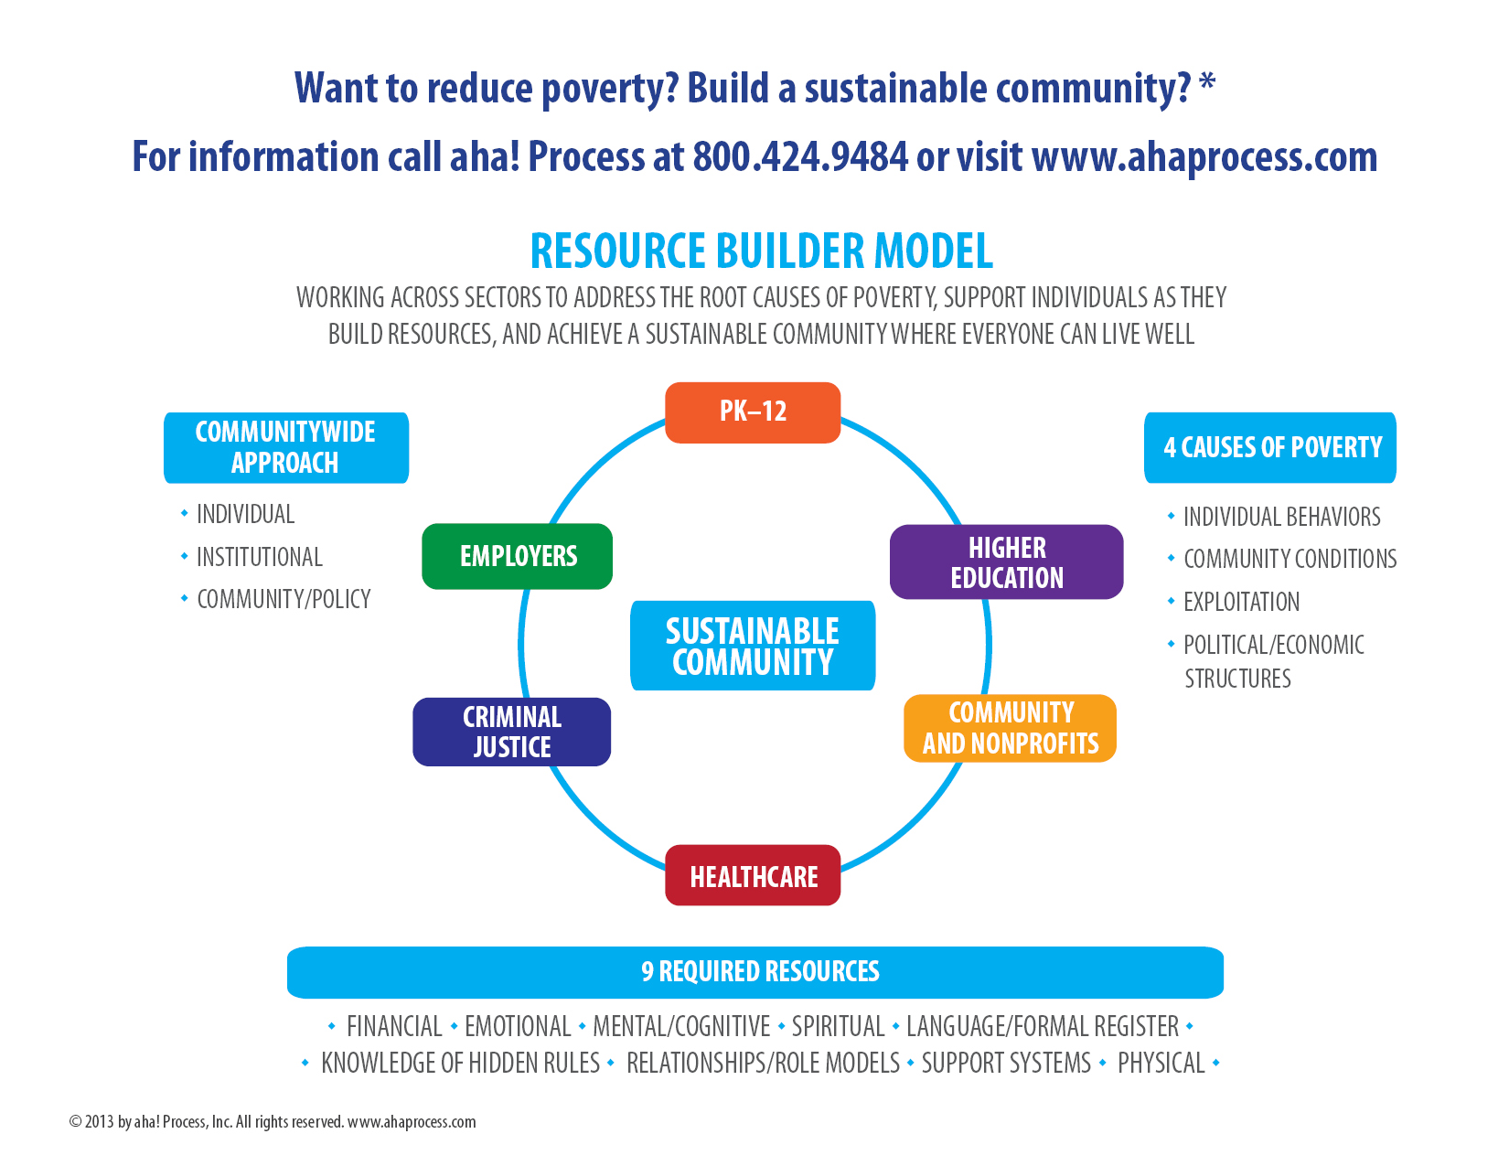

Slide 72
Christina Fulsom

Slide 73
EMPATHY
Notes:
IT’S TIME TO ASK OURSELVES – WHAT DO WE WANT EAST TEXAS TO BE?
WE CAN MAKE OUR COMMUNITY A BETTER PLACE – FOR ALL OF US – FOR OUR KIDS – BECAUSE WE ALL COUNT

Slide 74
WE ARE THEIR VOICE!
Notes:
WE ARE THE VOICE OF THOSE WHO ARE OFTEN UNSEEN AND UNHEARD.
5 YEAR OLD WITH BREIGHT EYES AND BEAUTIFUL SMILE
HUMBLE AND HOPEFUL EYES OF THE MOM COMING IN FOR HELP
SOFT BROKEN VOICE OF THE 68 Y.O. WITH SAD DISTRUSTFUL EYES

Slide 75
EAST TEXAS IS WHAT WE MAKE IT!
Notes:
IT’S TIME TO ASK OURSELVES – WHAT DO WE WANT EAST TEXAS TO BE?
WE CAN MAKE OUR COMMUNITY A BETTER PLACE – FOR ALL OF US – FOR OUR KIDS – BECAUSE WE ALL COUNT

Slide 76
FIND HELP
Charlotte Tharp

Slide 77
Find Help Activity
Part One:
  Choose one of the pieces of the puzzle on your table.
  Identify the name of the person represented.
  Find the corresponding name of the person on the activity handout.
  Read the scenario of the person you represent.
  Identify the name of the service provider that will assist with your scenario.
  Proceed to the corresponding service provider identified in the handout.
Part Two:
  Return to your table and in round-robin fashion share the information you obtained from the service provider that would assist your person.
  When everyone has shared, keep your puzzle piece as a reminder of how help is available in our community.

Slide 78
Partnership 4 Education
Christi Khalaf, Tyler Area Business Education Council

Slide 79

Cost of Poverty Convening
December 12, 2014
“Connecting Education and Economic Development”

Slide 80






























Tyler Area Partnership 4 Education
A.W. Riter Jr. Family Foundation
Notes:
Formed by the Business Education Council, this is a cross-sector group of leaders who come together to support education in Smith County. The group includes civic, non profit, faith based, business and education leaders.

Slide 81
Why We Exist
In 1973, only 28% of all U.S. jobs required postsecondary education/skills. By 2020, 65% of the jobs will require this level of education.
U.S. Workforce Projections by Required Education Level, 2020
Source: Georgetown University Center on Education and the Workforce, July2012
Property of the Tyler Area Business Education Council. For Discussion Purposes Only.
Notes:
In 1973, only 28% of all jobs required some postsecondary education. According to the Center on Education and the Workforce, 65% of all jobs will require postsecondary education by 2020. This is a number derived from asking asking employers across the country what their expectations for the workforce they will hire most likely will be.

Slide 82
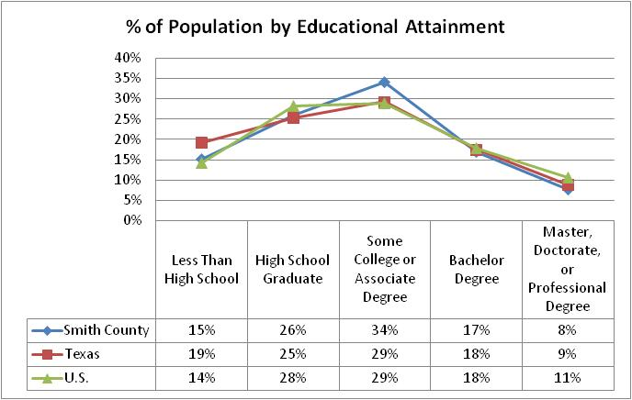
Educational Attainment:
Smith County (Age 25 and over)
Only 35% have earned an associates degree or higher
Sources: American Community Survey, 2008-2012
Property of the Tyler Area Business Education Council. For Discussion Purposes Only.
Notes:
In Smith County today, 35% of residents over the age of 25 have earned an associates or higher. There are many who have attended college but have not earned a credential as well. And of course there are almost half that have no education beyond high school.
Recent studies show that the trend is going in the wrong direction with only 20% of students ultimately post secondary credential.

Slide 83
Education and Poverty
Poverty rates decline significantly as education level rises
Source: US Census, ACS, 2011
Property of the Tyler Area Business Education Council. For Discussion Purposes Only.
Notes:
As education levels rise, income level rises and poverty levels decline. There is an enormous advantage to education beyond high school – in Smith County and all across the US

Slide 84
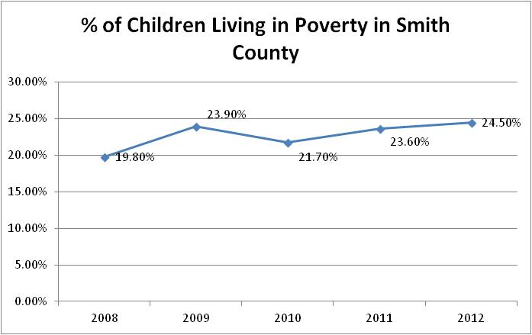
Childhood Poverty
24% of children in Smith County live in poverty and 30% live in single parent homes
Source: U.S. Census Bureau, Small Area Income and Poverty Estimates Program
Property of the Tyler Area Business Education Council. For Discussion Purposes Only.
Notes:
According to the National Student Clearinghouse Research Center, poverty, not race, ethnicity, national origin or where you attend school - is the best predictor of college attendance and completion
40% of children living in poverty and not prepared for primary school.

Slide 85
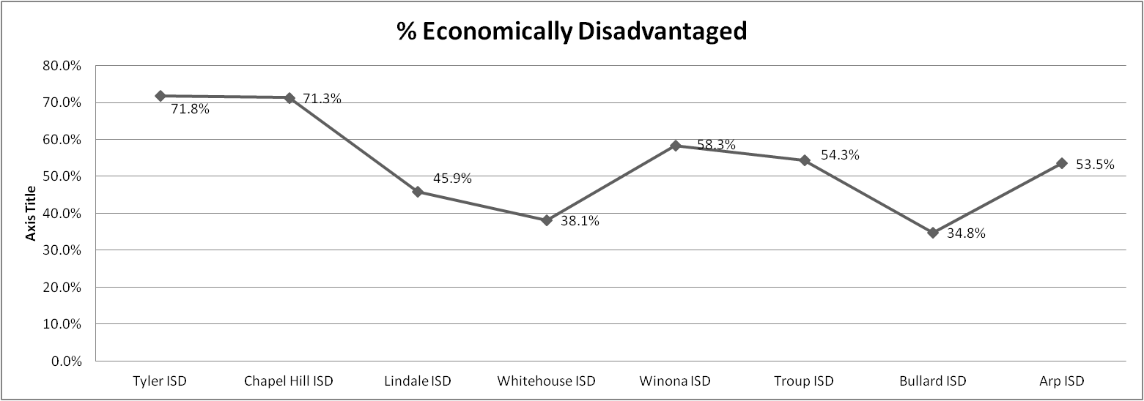
Smith County K-12 Public: Socioeconomics
In total, 57% of Smith County students are economically disadvantaged
Texas (60.4%)
Note: Economically disadvantaged defined by free and reduced lunch participation
Source: Texas Education Agency TAPR 2013-2014
Property of the Tyler Area Business Education Council. For Discussion Purposes Only.
Notes:
Research shows that these students are 8x less likely to earn a post-secondary credential than their economically stable counterparts

Slide 86







Tyler Area Partnership 4 Education
Working to ensure success through education by focusing on key milestones along the education continuum and utilizing the principles of Collective Impact
Young adults
enter a career
Young adults
complete college or
advanced career
training
High School
graduates are
college ready
Successful
transition from
middle school
to high school
Children read at
grade level in
3rd grade
Children enter
school ready
to succeed
Property of the Tyler Area Business Education Council. For Discussion Purposes Only.

Slide 87
Support and Partnerships
Educate Texas
  A public-private partnership focused on improving the public education system in Texas
Texas Collective Impact Network
  A network of communities from across the state working toward the common goal of increasing educational attainment
Lumina Foundation Community Partnership for Attainment:
  75 communities from across the nation working to dramatically increase the number of local residents with postsecondary credentials
Property of the Tyler Area Business Education Council. For Discussion Purposes Only.
Notes:
Educate Texas, an initative of the communities foundation of texas, has made tremendous strides across the state and specifically in the RGV and Dallas area. Their early college high school and college access network focus has lead to measureable improvement in attainment rates. We are also supported by collective impact organizations across the state and are hoping to work with the Lumina Foundation in the future as part of their community partnership for attainment.

Slide 88
Looking Forward
Action teams will be formed to address specific issues related to educational attainment
Experts and passionate community members will be brought to the table to discuss solutions and to help build upon what is working in Smith County
Best practices will be identified and implemented with the goal of producing sustainable, scalable and measureable results
Property of the Tyler Area Business Education Council. For Discussion Purposes Only.

Slide 89
Christina Fulsom
Finding your voice

Slide 90
DISCOVERY

Slide 91
The human spirit is full of hope and intelligence, resilient by nature, boundless in its potential to serve the common good.
Stephen Covey

Slide 92
FINDING YOUR VOICE
Notes:
Talent – what you are good at
Passion – what you love doing
Conscience – What you feel is right, what you should be doing, and
Need – an area where there is pain, where there is a place to add value in all parts of society.
Your voice is revealed when you engage in work that taps your talent, fuels your passion, rises out of a great need in your community that you feel drawn by conscience to meet.

Slide 93
THANK YOU!

