Slide 1

COMMUNITY AWARENESS CAMPAIGN

Slide 2
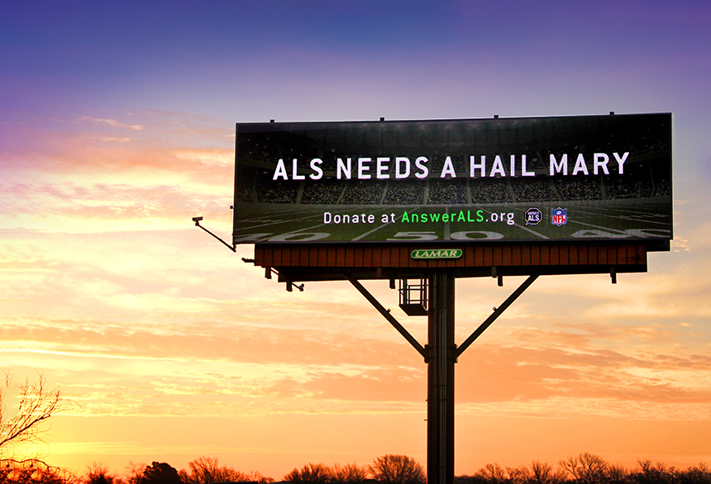

BILLBOARDS

Slide 3


PRESS RELEASE
Tell mom about 903HELP!

Slide 4

TV & RADIO
PUBLIC SERVICE ANNOUNCEMENTS

Slide 5


@HumanNeedsNetwork
Like
Share
Like
Retweet
@ET_human_needs

Slide 6


1. EMBED BUTTON ON YOUR
WEBSITE

Slide 7
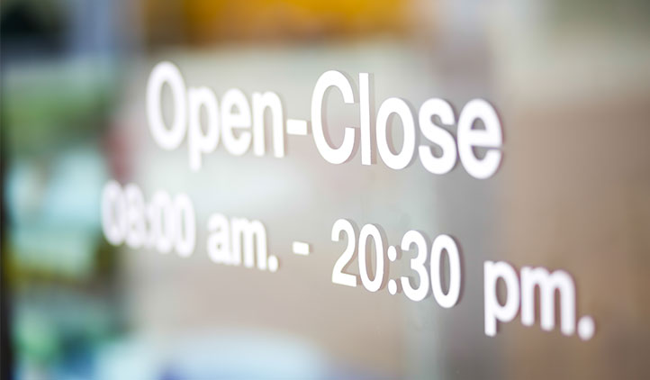


2.
DISPLAY PARTNER DECAL

Slide 8

3.
DISPLAY POSTER

Slide 9
5. LET EVERYONE KNOW!
Did you know?
Clients
Staff
Volunteers
Board
Sunday school classes
social clubs

